Slide 1

Industrial Machine Learning on Hadoop and Spark
Maks Nakhodnov, Bremen 2025

Slide 2
Distributed computing. Spark
Plan:
Spark — main abstractions and objects
Actions and transformations
RDD API
DataFrame API

Slide 3
Spark
Plan:
Spark — main abstractions and objects
Actions and transformations
Data locality. Serialization

Slide 4
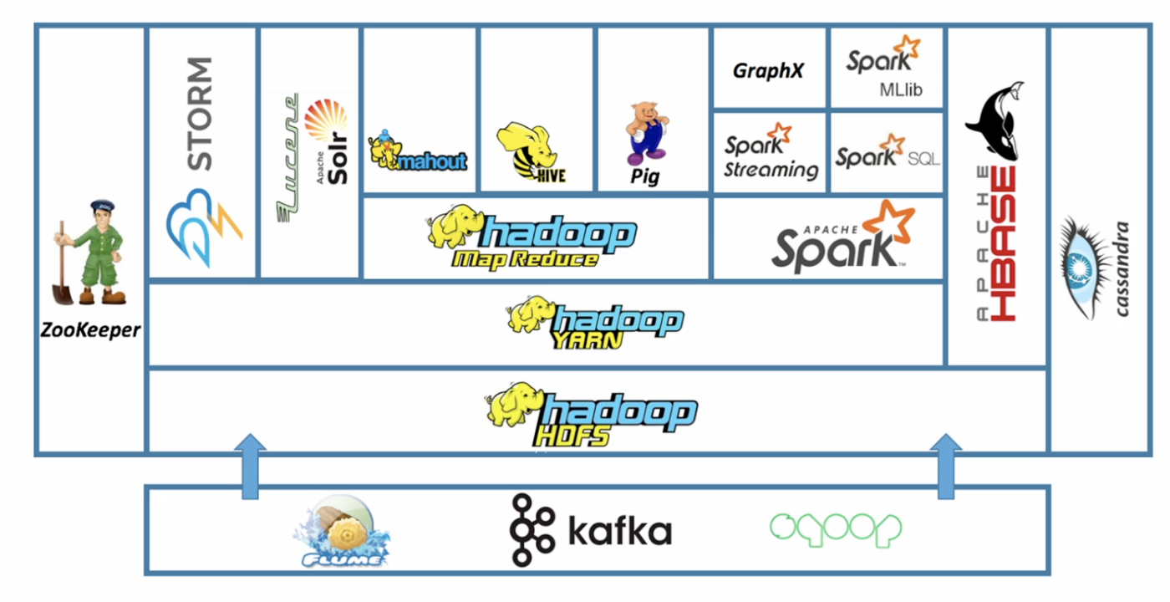
Spark. Motivation

Slide 5
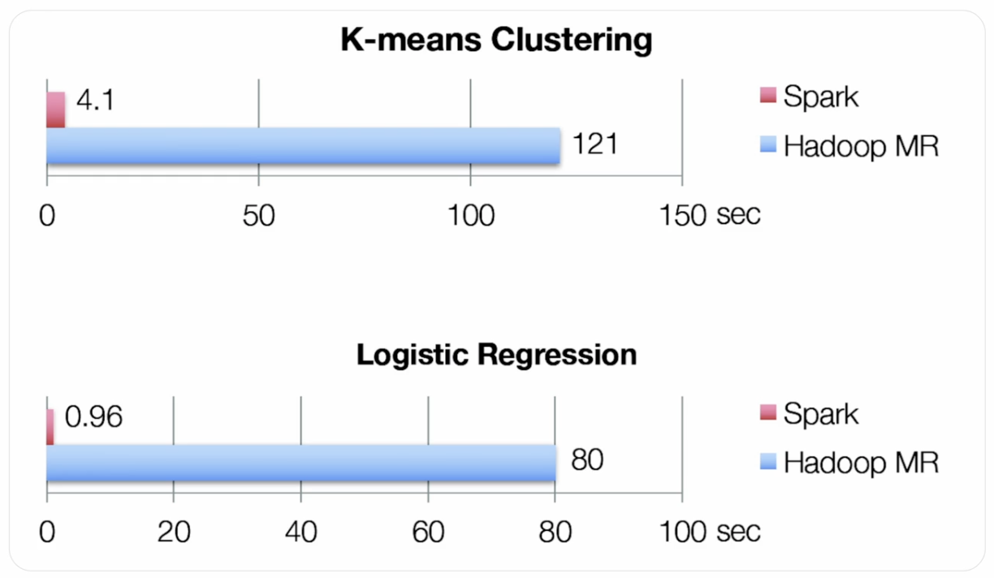
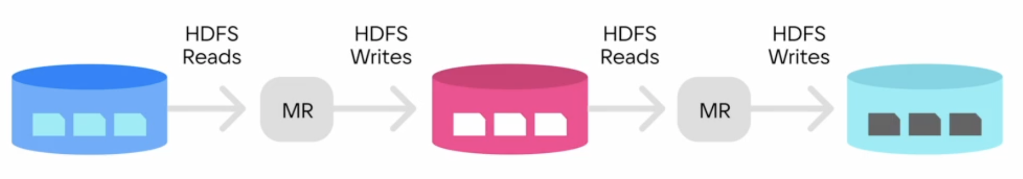
Spark vs MapReduce

Slide 6
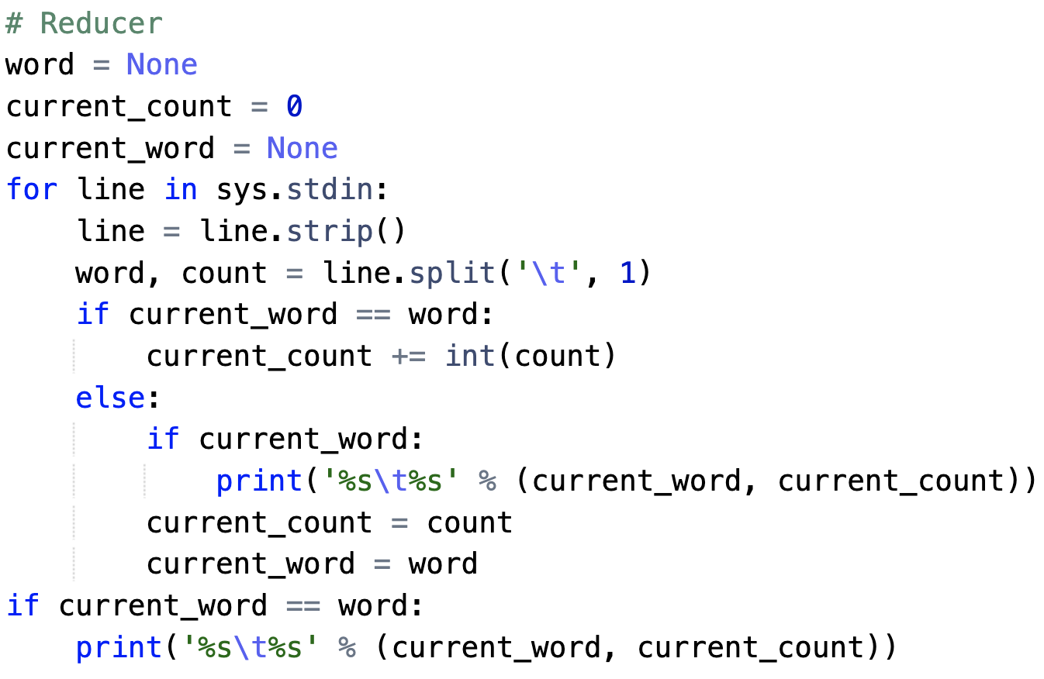
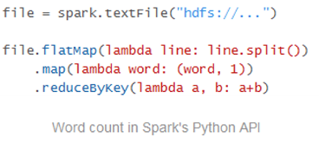
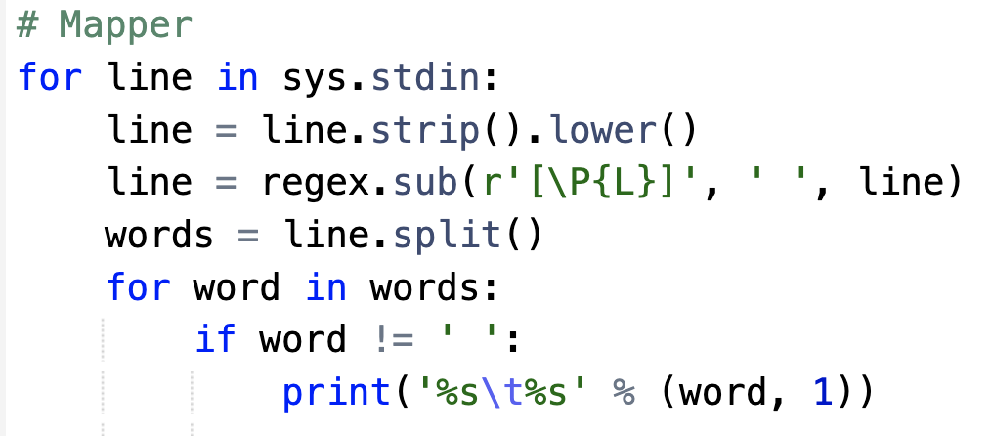
Spark vs MapReduce
MapReduce:
Usually runs slowly
Mappers write intermediate data to disk before transferring it over the network
No query optimization
Sequential jobs must interact with HDFS — bad for iterative tasks
Not interactive
Hard to create complex pipelines
Spark:
Usually runs much faster
Stores intermediate results in RAM
Optimizes queries
Not tied to HDFS
Can be used interactively
Easy to program on

Slide 7
Spark vs MapReduce
To solve both types of problems, one thing is needed that MapReduce lacks:
Efficient primitives for data sharing
In MapReduce, the only way to share data between jobs is through stable storage
Replication also slows down the system, but it’s necessary to ensure fault tolerance

Slide 8
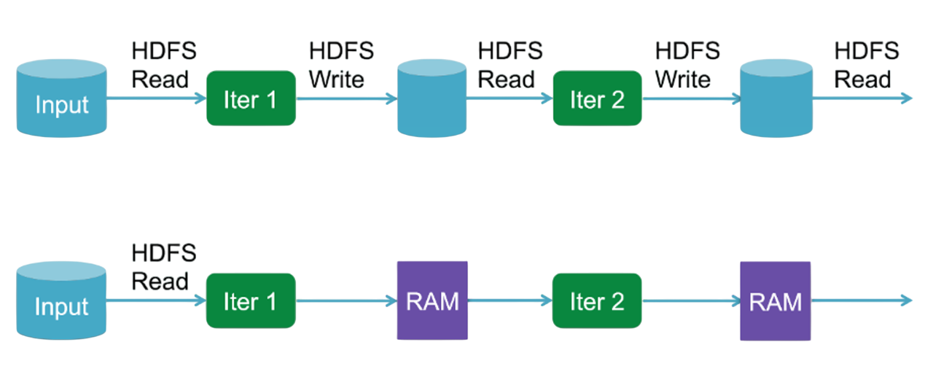
MapReduce vs Spark. Sequential Jobs

Slide 9
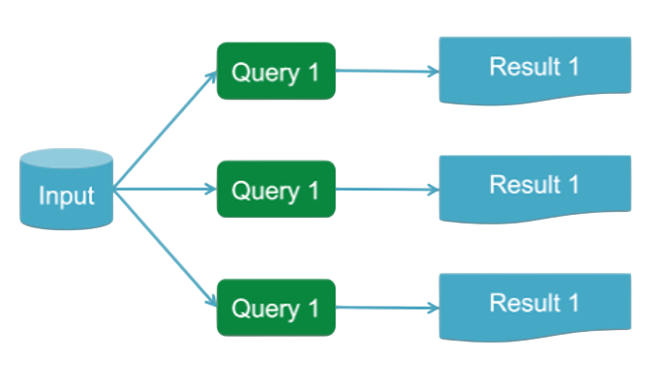
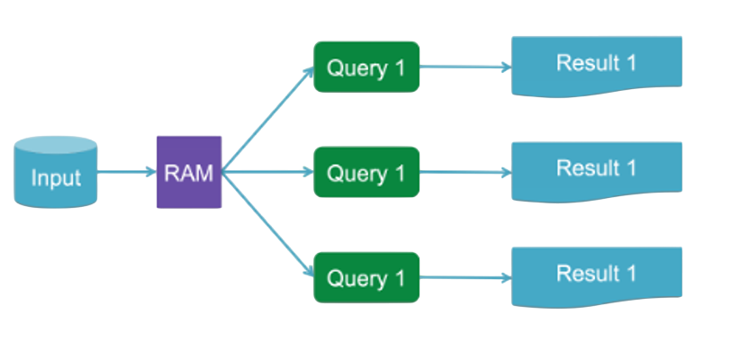
MapReduce vs Spark. Multiple Jobs

Slide 10

Spark Outline
History:
Developed at UC Berkeley’s AMPLab in 2009
Became a top-level Apache project
http://spark.apache.org/
Easy:
Easy to write applications in Java, Scala, R, and Python
Supports various data types
Generality:
Combines SQL, streaming, and complex analytics within a single application
Spark SQL, MLlib, GraphX, and Spark Streaming
Runs anywhere:
Hadoop, Mesos, standalone, or in the cloud
Accesses data from various sources (HDFS, Cassandra, HBase, S3)

Slide 11
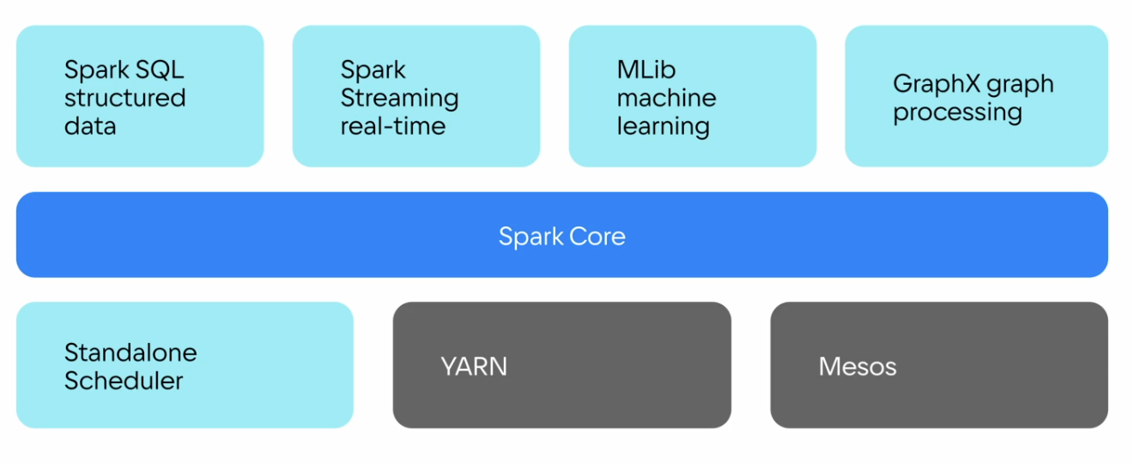
Spark Components

Slide 12
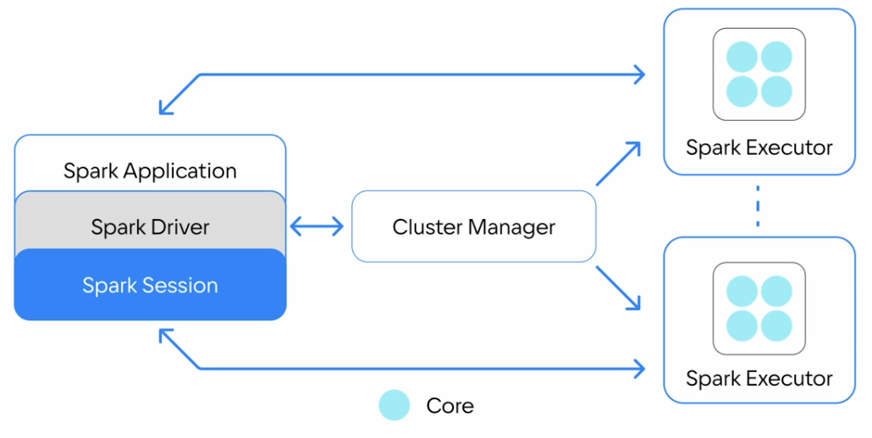
Spark Architecture
Application:
A user application written in Spark. Consists of a driver and executors.
Driver program:
The program containing the main() function that creates and runs the SparkContext.
Deploy mode:
In cluster mode, the driver runs inside the cluster. In client mode, the driver runs outside the cluster.
Executor:
A process launched on a worker node to execute the application.

Slide 13
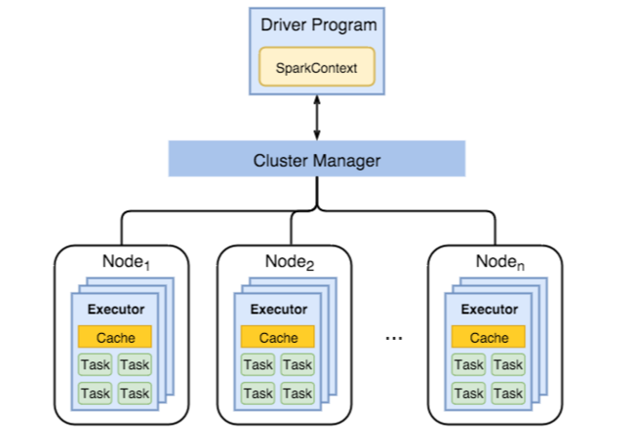
Spark Workflow
Driver:
Initializes the application
Requests resources
Builds the physical plan
Sends serialized task code
Monitors task execution
Finalizes the application
Requests resource release
Executors:
Receive specific tasks from the driver
Send execution status back to the driver
Terminate execution upon the driver’s command
SparkSession

Slide 14
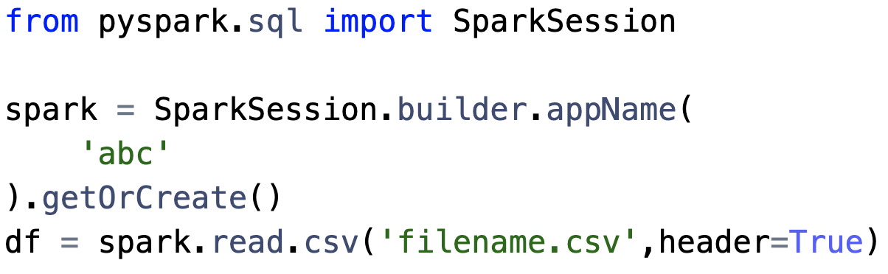
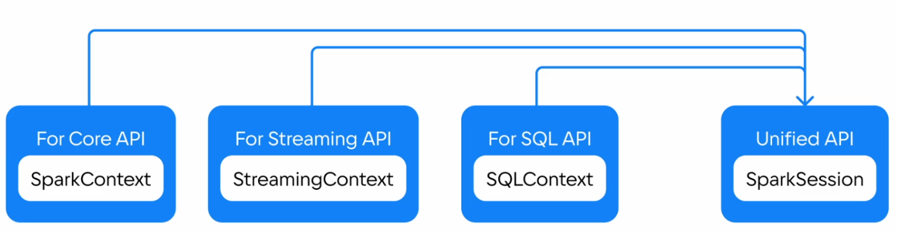
SparkSession
Unified Entry Point:
A single point of interaction for various Spark APIs
Configuration Management:
Allows for the configuration of Spark properties, such as application name, master URL, and memory settings.

Slide 15
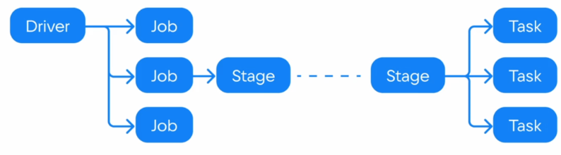
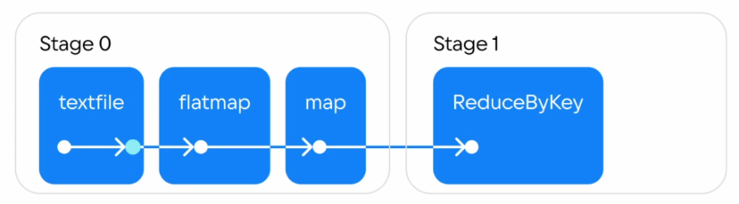
Spark Runtime
Task
The smallest unit of work that will be sent to an executor
Job
A parallel computation consisting of multiple stages, triggered by an action in Spark (e.g., save, collect)
Stage
A set of tasks into which each job is divided (similar to Map and Reduce phases in MapReduce)
Driver
Coordinates execution, schedules jobs, and manages task distribution

Slide 16
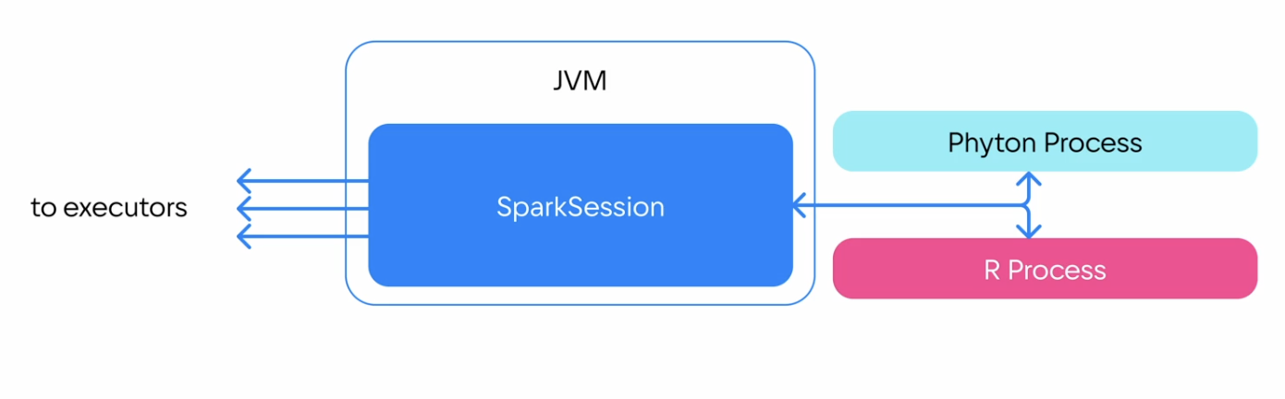
Spark External Processes
Spark supports Java and Scala natively
Python and R communicates with the JVM to transfer data:
Slow for User Defined Functions
Slow for large actions outputs
Python Process

Slide 17
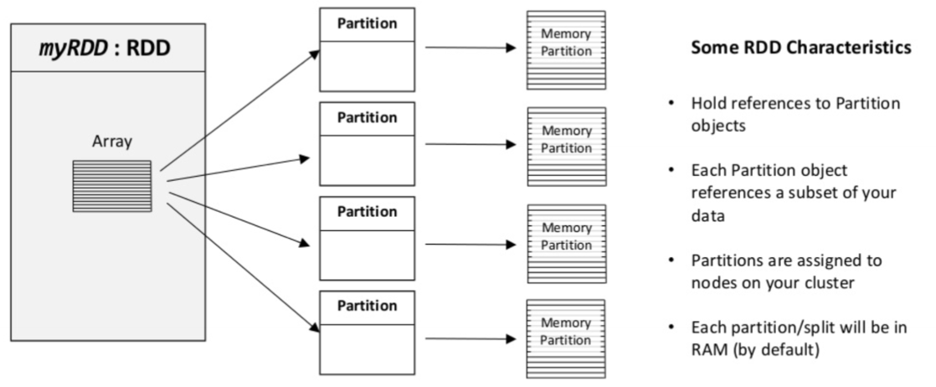
Spark. RDD API

Slide 18
Spark. RDD API
RDD (Resilient Distributed Dataset) — an immutable distributed collection of objects
It has three key characteristics:
Dependencies
Tracks how this RDD depends on other RDDs for fault tolerance
Stores Lineage Graph
Partitions (with some locality information)
Can create distributed collections from local FS, HDFS, Cassandra, HBase, Amazon S3, etc.
Can be stored on different nodes
Compute function: Partition => Iterator[T]
Spark supports text files, SequenceFiles, Hadoop InputFormats, …

Slide 19
Spark. Programming Model
Based on parallelizable operators
These operators are higher-order functions that execute user-defined functions in parallel.
A data processing pipeline consists of any number of data sources, operators, and data sinks by connecting the outputs of some operations to the inputs of others.

Slide 20
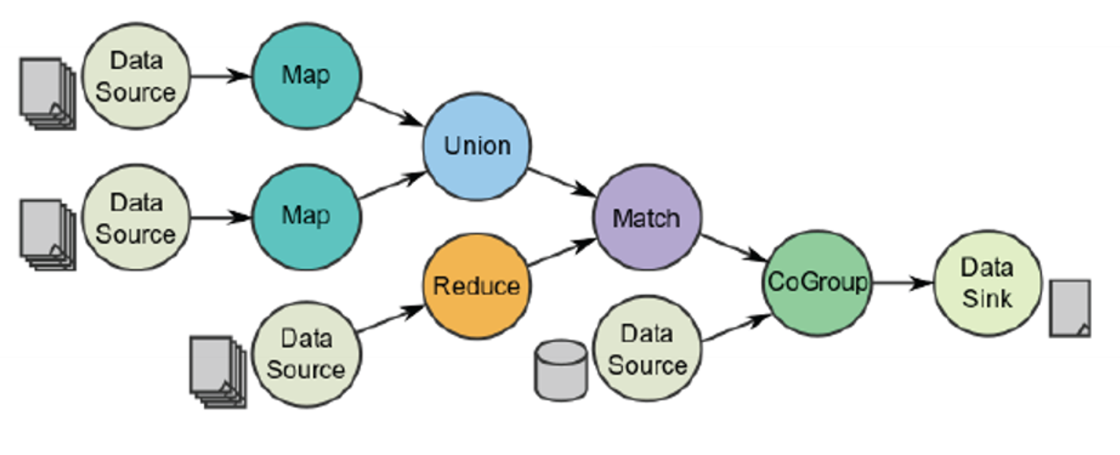
Spark. DAG
The task is defined using the directed acyclic graphs (DAG):
Vertices represent RDDs
Edges represent the operation to be applied to the RDD
Each edge points from an earlier to a later stage
DAG scheduler splits the graph into stages and tasks

Slide 21
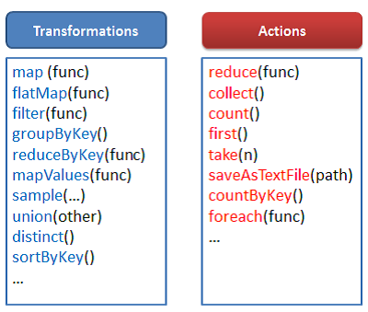
Spark. High-Order Functions
There are two types of operators:
transformations and actions.
Transformations:
Lazy operators that create new RDDs
Perform transformations of the form RDD → RDD
Actions:
Trigger computation and return results to the program or write data to external storage
Performs transformations of the form RDD → actual data

Slide 22
Spark. Lazy Evaluation
The Spark programming model is based on lazy evaluation:
At the moment of job execution, transformations on a specific RDD are not performed until at least one action is called on it
Spark doesn’t store results of the transformations by default:
Use transformations cache() or persist() to store the data in memory or on disk after it's computed

Slide 23
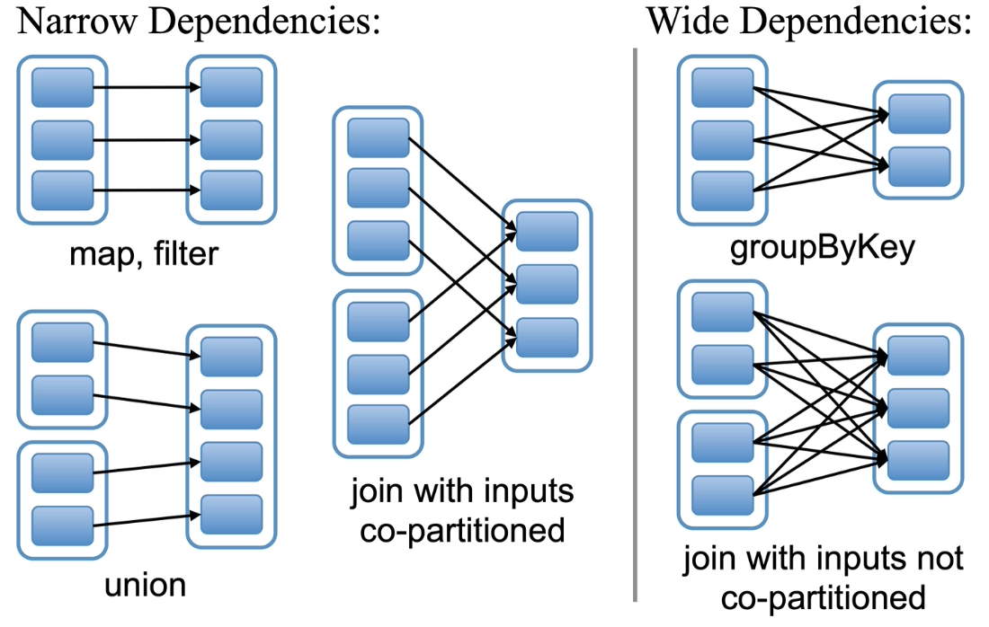
RDD API. Wide & Narrow Transformations
There are two types of dependencies between RDDs:
Narrow dependencies:
Each partition of the parent RDD is used by at most one partition of the child RDD
Allow pipelined execution on a single cluster node.
Example: a filter followed by a map.
Wide dependencies:
Each partition of the parent RDD is used by multiple partitions of the child RDD
Usually requires shuffling across nodes
Defines the boundary between Stages

Slide 24
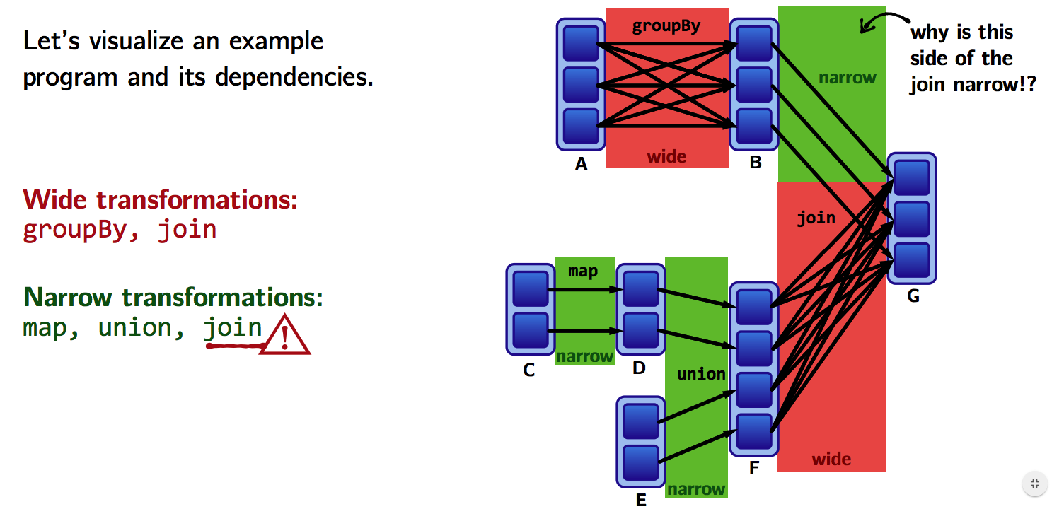
RDD API. Wide & Narrow Transformations
Use RDD.dependencies or RDD.toDebugString to analyze

Slide 25
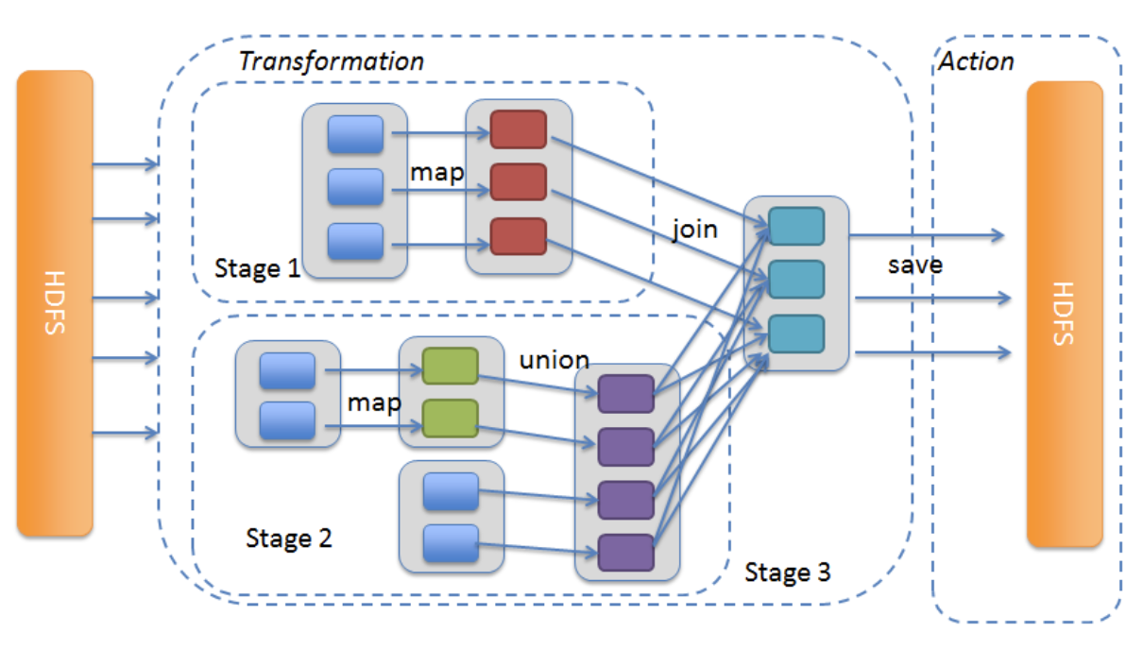
Spark. Job Scheduling
When a user triggers an action on an RDD, the scheduler builds a DAG from the stages of the RDD Lineage Graph:
A stage contains various pipelined transformations with narrow dependencies.
Boundaries for a stage are defined by:
Shuffles for wide dependencies
Partitions that have already been processed

Slide 26
Spark. Job Scheduling
The scheduler launches tasks to process the remaining partitions (missing partitions) from each stage until the target RDD is computed
Tasks are assigned to machines based on data locality
If a task requires a partition that is available in memory on a node, the task is sent to that node

Slide 27
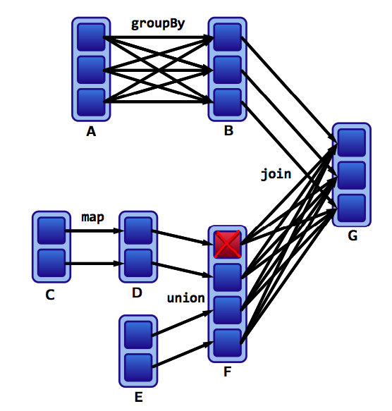
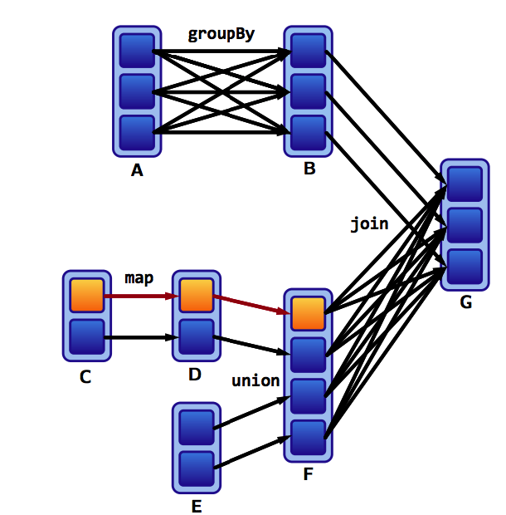
Spark. Fault Tolerance

Slide 28
Spark. Fault Tolerance
RDD maintains lineage information, which can be used to recover lost partitions:
Intermediate results from wide dependencies are materialized on nodes responsible for the parent partitions to simplify fault recovery
If a task fails, it will be restarted on another node as long as parent stages are available
If some parent stages become unavailable, tasks are submitted to recompute the missing partitions in parallel
Recovery can be time-consuming for RDDs with long lineage chains and wide dependencies
It may be useful to persist certain RDDs to reliable storage
The decision of what to persist is left to the developer

Slide 29
Spark. Memory Management
If there is not enough memory for new RDD partitions, LRU (least recently used) eviction is used:
Spark provides three options for storing persistent RDDs:
In-memory storage as deserialized Java objects
In-memory storage as serialized Java objects
On-disk storage

Slide 30
Spark. Memory Management
For persistent RDDs, each node keeps any RDD partitions in RAM, allowing new actions to execute much faster
This is done using the persist() or cache() methods
Different storage levels:
MEMORY_ONLY
MEMORY_AND_DISK
MEMORY_ONLY_SER
MEMORY_AND_DISK_SER
MEMORY_ONLY_2, MEMORY_AND_DISK_2, etc.

Slide 31
Spark. Shared Variables
Sometimes it is necessary for a variable to be shared between tasks or between tasks and the driver program
Using regular read-write shared variables between tasks is inefficient:
Read-only — Broadcast Variables
Write-only — Accumulators

Slide 32
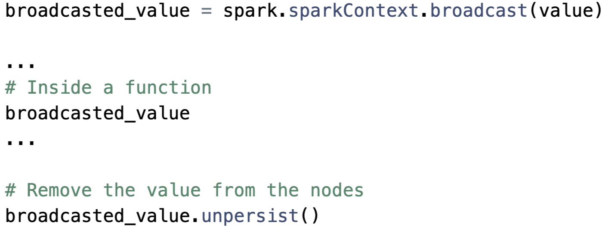
Spark. Broadcast Variables
Read-only variables are cached on each machine instead of sending a copy to every operation
Broadcast Variables are sent to a node only once

Slide 33
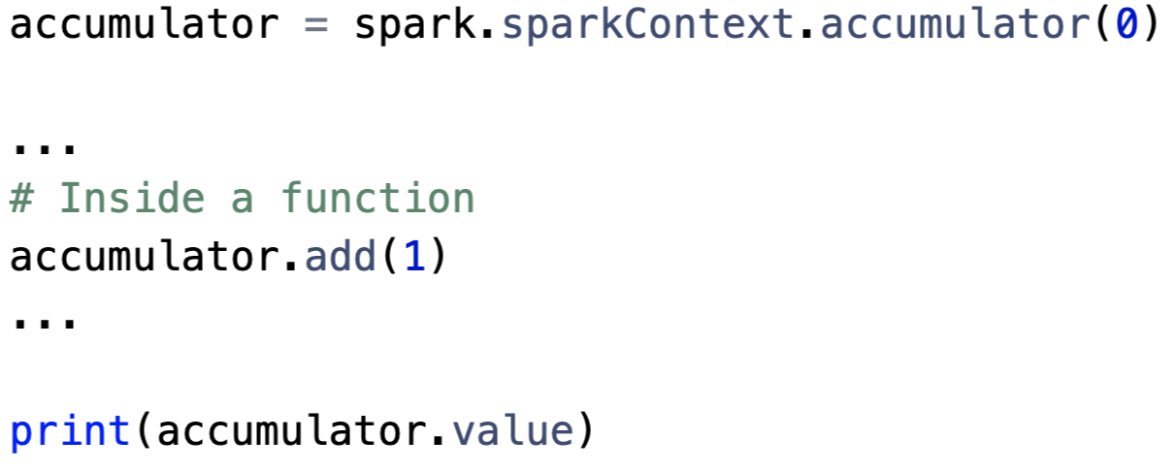
Spark. Accumulators
Variables that can only be incremented
Can be used to implement counters and accumulators
Tasks running on the cluster can then add values using the += operator

Slide 34
Spark. Use cases
Applications suitable for RDDs:
Batch applications that apply a single operation to all elements in a dataset
Applications not suitable for RDDs:
Applications performing asynchronous fine-grained updates, modifying shared state (e.g., storage systems for web applications)

